Slide 1
Blinkit
Grocery Dataset Analysis

Slide 2
Blinkit Analysis
STEPS IN PROJECT
Requirement Gathering / Business Requirements.
Data Walkthrough.
Data Connections.
Data Cleaning Quality Checks.
Data Modelling.
Data Processing.
DAX Calculations.
Dashboard Layout.
Charts Developments and Formatting.
Dashboard / Report Development.
Insight Generation.

Slide 3
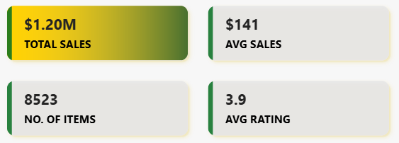
Blinkit Analysis
BUSINESS REQUIREMENTS
To conduct a comprehensive analysis of Blinkit’s sales performance, Customer Satisfaction and inventory distribution to Identify key insights and opportunities for optimization using various KPIs and visualization in Power BI.
KPI’s Requirements
Total Sales : The overall Revenue generated from all items sold.
Average Sales : Average Revenue per Sale.
Number of Items : The Total Count of different Items sold.
4. Average Rating : The Average customer rating for items sold.

Slide 4
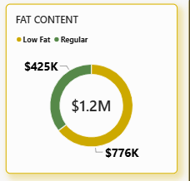
Blinkit Analysis
1. Total sales by FAT Content:
  Objective : Analyse the impact of fat content on total sales.
  Additional KPI metrics : Assess how other KPIs (Avg. sales, No. of items Avg. Rating) vary with fat content.
  Chart type : Donut Chart.

Slide 5
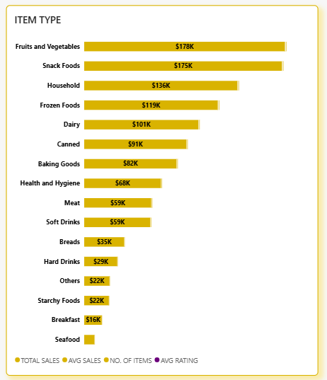
Blinkit Analysis
2. Total sales by Item Type:
  Objective : Identify the performance of different item types in terms of total sales.
  Additional KPI metrics : Assess how other KPIs (Avg. sales, No. of items Avg. Rating) vary with fat content.
  Chart type : Bar Chart.

Slide 6
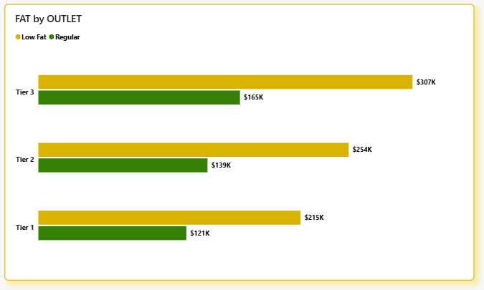
Blinkit Analysis
3. FAT Content by Outlet for total sales:
  Objective : Compare total sales across different outlet segmented by Fat Content.
  Additional KPI metrics : Assess how other KPIs (Avg. sales, No. of items Avg. Rating) vary with fat content.
  Chart type : Stacked Column Chart.

Slide 7
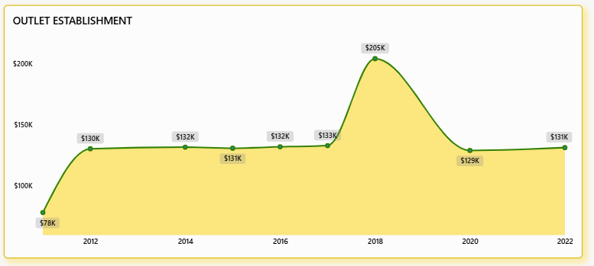
Blinkit Analysis
4. Total sales by Outlet Establishment:
  Objective : Evaluate how the Age or Type of outlet establishment influences total sales
  Chart type : Line Chart.

Slide 8
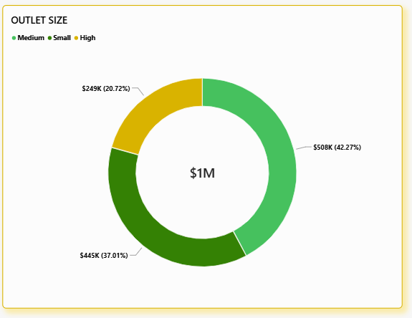
Blinkit Analysis
5. Sales by Outlet Size:
  Objective : Analyse the Correlation Between Outlet Size and Total Sales.
  Chart type : Donut / Pie Chart.

Slide 9
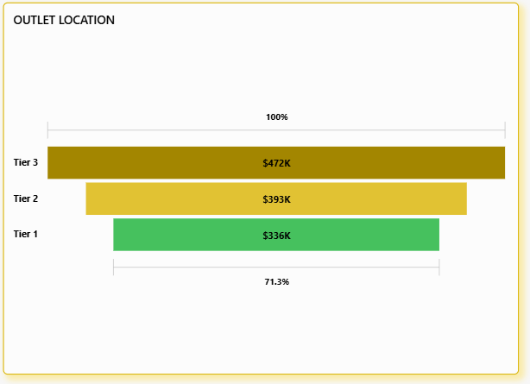
Blinkit Analysis
6. Sales by Outlet Location:
  Objective : Assess the geographic distribution of sales across different locations.
  Chart type : Funnel Chart.

Slide 10
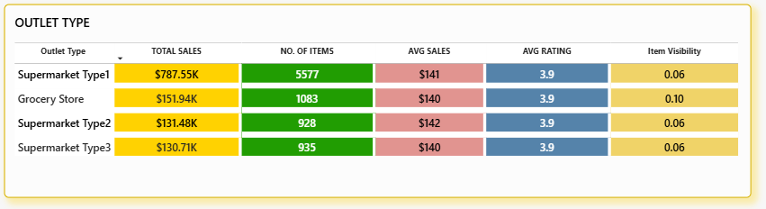
Blinkit Analysis
7. All Metrics by Outlet Type:
  Objective : Provide a comprehensive view of all key metrics (Total sales, Avg. sales, No. of items Avg. Rating) broke
  down by different outlet types.
  Chart type : Metrics Card.

Slide 11
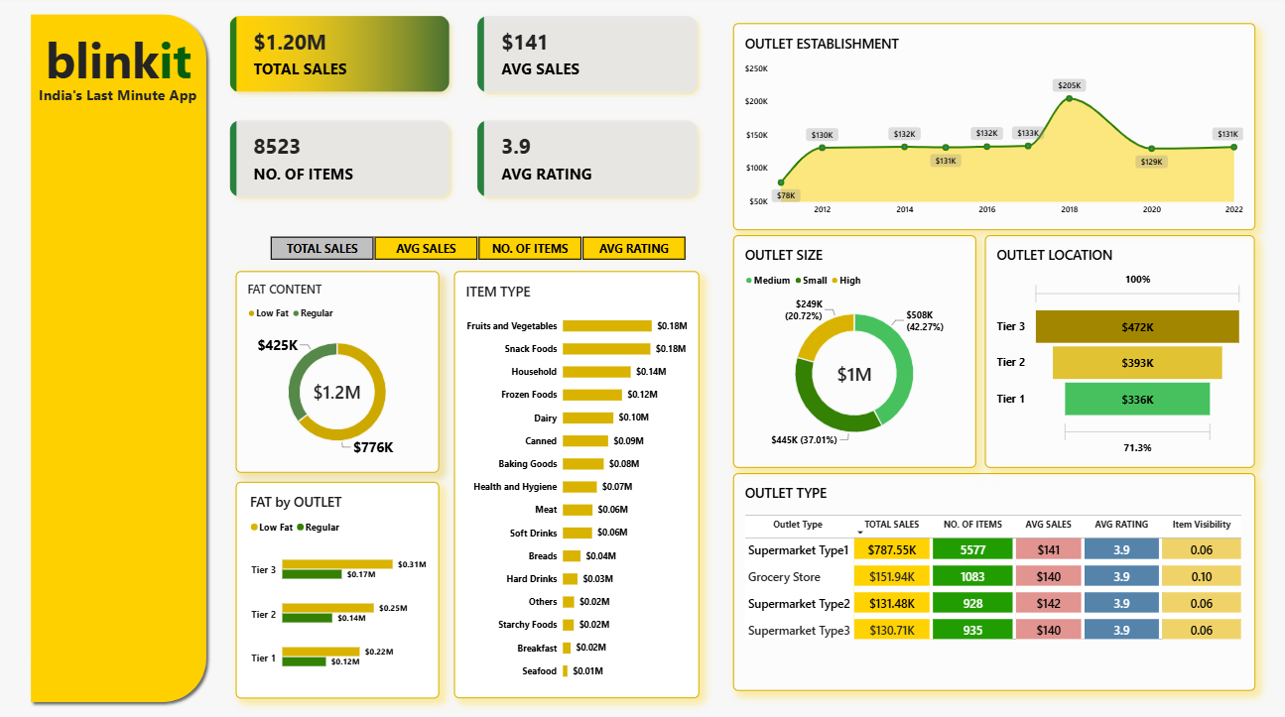
Blinkit Analysis
POWER-BI DASHBOARD

Slide 12
Blinkit Analysis
Key Takeaways
Low Fat products generated 776,319.69 in sales (64.60%), compared with 425,361.80 (35.40%) for Regular products.
Fruits and Vegetables generated the highest total sales at 178,124.08, contributing 14.82% of overall sales.
Supermarket Type1 generated the highest sales for both Low Fat (507,886.30) and Regular products (279,663.59).
Outlets associated with 2018 recorded the highest total sales: 204,522.26, approximately 17.02% of overall sales.
Medium-sized outlets generated the highest total sales: 507,895.74 (42.27%).
Tier 3 locations generated the highest sales at 472,133.03 (39.29%).
Supermarket Type1 dominates sales, contributing 787,549.89, or 65.54% of total sales.

Slide 13
Blinkit Analysis
Business Recommendations
Maintain strong availability of Low Fat products, given their substantial contribution to total sales.
Prioritize shelf availability and replenishment for Fruits and Vegetables and Snack Foods to protect their substantial sales contributions.
Ensure adequate inventory of both fat-content categories in Supermarket Type1 outlets, particularly for fast-moving products.
Investigate the factors behind the 2018 group's strong total sales, including assortment, outlet format, location, and customer demand.
Study the product mix, customer demand, and operational practices of Medium outlets to understand their large contribution to total sales.
Investigate the demand drivers in Tier 3 locations and assess whether similar product assortment strategies could work in other locations.
Protect Supermarket Type1's sales contribution through effective inventory management, replenishment, and monitoring of fast-moving products.

Slide 14
Blinkit Analysis
QnA

Slide 15
Blinkit Analysis
THANK
YOU…!!!

